Slide 1
More about Machine Translation
SIU Sai Cheong
School of Translation, Hang Seng Management College

Slide 2
MT Evaluation

Slide 3
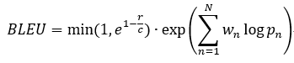
Automatic Evaluation
The use of Bilingual Evaluation Understudy (BLEU) metric (Papineni, Roukos, Ward, & Zhu, 2002), a measure of n-gram precision with a value between 0 and 1, comparing a machine translation output with a reference:

Slide 4
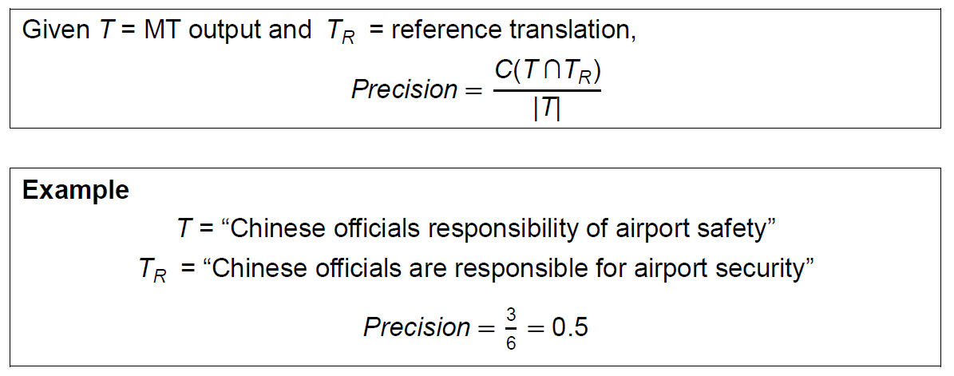
More about BLEU
For more information, visit
https://www.aclweb.org/anthology/P02-1040.pdf

Slide 5
More about SMT

Slide 6
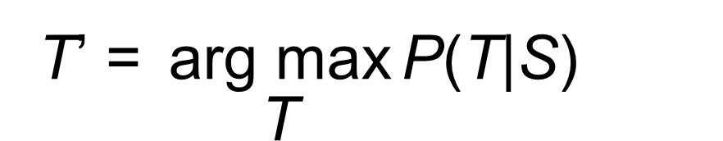
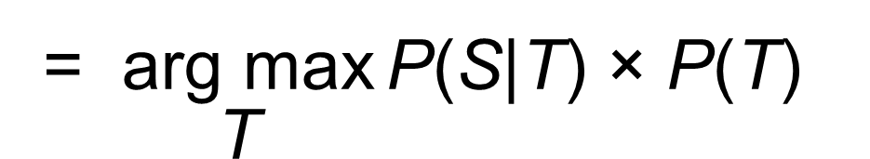
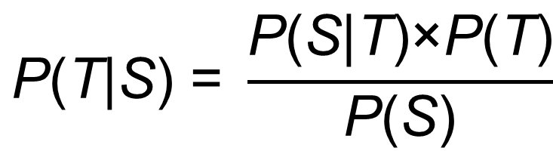
Statistical Machine Translation
$$\text{P}\text{(}\text{T}\text{|}\text{S}\text{) = }\frac{\text{P}\text{(}\text{S}\text{|}\text{T}\text{)×}\text{P}\text{(}\text{T}\text{)}}{\text{P}\text{(}\text{S}\text{)}}$$
T’ $\text{=} \underset{\text{T}}{\text{arg} \text{max}}{\text{P}\text{(}\text{T}\text{|}\text{S}\text{)}}$
= $\underset{\text{T}}{\text{arg} \text{max}}{\text{P}\text{(}\text{S}\text{|}\text{T}\text{) × }\text{P}\text{(}\text{T}\text{)}}$
Translation Model
Language
Model

Slide 7
SMT(1): Language Model

Slide 8
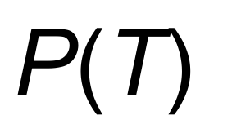
Language Model
Do you prefer fish ?
Elephants love her .
Give me fish .
Dogs love swimming .
We love dogs .
$$\text{P}\text{(}\text{T}\text{)}$$
Monolingual Corpus in the Target Language

Slide 9
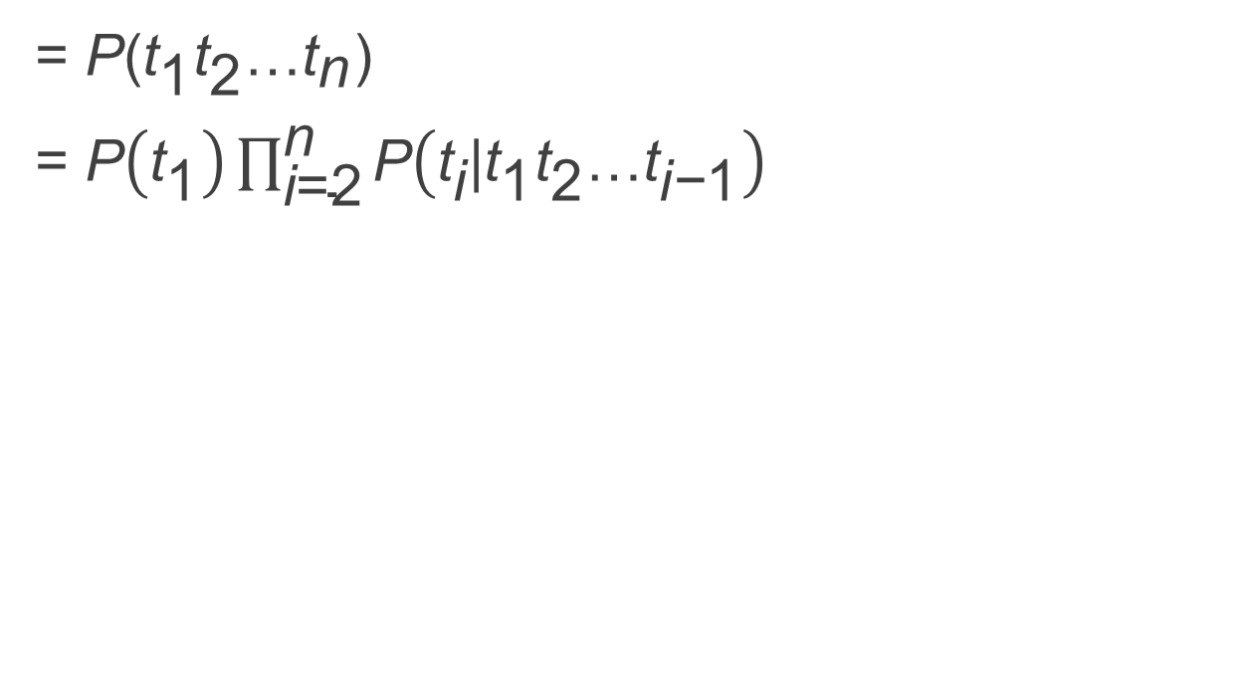
P(T)
= P(${\text{t}}_{\text{1}}{\text{t}}_{\text{2}}\text{…}{\text{t}}_{\text{n}}$)
= $\text{P}\left({\text{t}}_{\text{1}}\right)\prod_{\text{i}\text{=2}}^{\text{n}}{\text{P}\left({\text{t}}_{\text{i}}\text{|}{\text{t}}_{\text{1}}{\text{t}}_{\text{2}}\text{…}{\text{t}}_{\text{i}\text{−}\text{1}}\right)}$

Slide 10
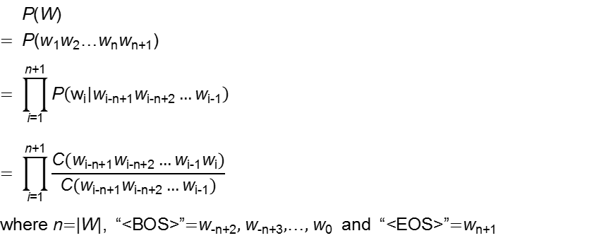
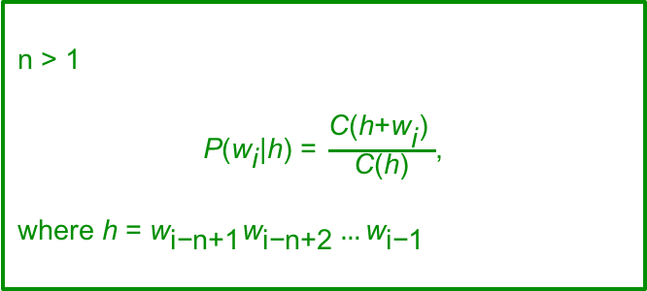
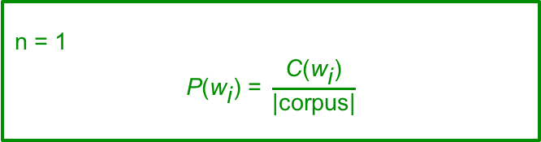
N-gram Model
We consider n words at a time (i.e., the word w and n-1 words in the context history h).
n = 1
$$\text{P}\text{(}{\text{w}}_{\text{i}}\text{) =} \frac{\text{C}\text{(}{\text{w}}_{\text{i}}\text{)}}{\text{|}\text{corpus}\text{|}}$$
n > 1
$\text{P}\text{(}{\text{w}}_{\text{i}}\text{|}\text{h}\text{) =} \frac{\text{C}\text{(}\text{h}\text{+}{\text{w}}_{\text{i}}\text{)} }{\text{C}\text{(}\text{h}\text{)}}$,
where h = ${\text{w}}_{\text{i}\text{−}\text{n}\text{+1}}{\text{w}}_{\text{i}\text{−}\text{n}\text{+2}}…{\text{w}}_{\text{i}\text{−}\text{1}}$

Slide 11
Unigram Model (n=1)

Slide 12
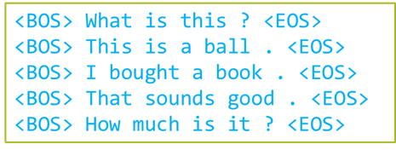
Unigram Model
P(“How much is this book?”)
= P(“how”)
× P(“much”)
× P(“is”)
× P(“this”)
× P(“book”)
× P(“?”)
× P(“<EOS>”)

Slide 13
Bigram Model (n=2)

Slide 14
Bigram Model
P(“How much is this book?”)
= P(“how”|“<BOS>”)
× P(“much”|“how”)
× P(“is”|“much”)
× P(“this”|“is”)
× P(“book”|“this”)
× P(“?”|“book”)
× P(“<EOS>”|“?”)

Slide 15
Trigram Model (n=3)

Slide 16
Trigram Model
P(“How much is this book?”)
= P(“how”|“<BOS><BOS>”)
× P(“much”|“<BOS> how”)
× P(“is”|“how much”)
× P(“this”|“much is”)
× P(“book”|“is this”)
× P(“?”|“this book”)
× P(“<EOS>”|“book ?”)

Slide 17
SMT(2): Translation Model

Slide 18
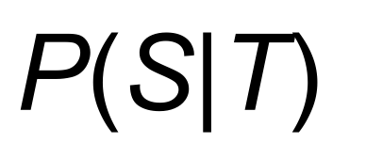
Translation Model
Source Language
我喜歡貓 。大象鍾意我 。人們喜歡狗 。他們嗜魚 。我們喜歡猴子 。你喜歡豬 。
Target Language
I love cats. Elephants love me. People love dogs. They prefer fish. We love monkeys. You prefer pigs.
$$\text{P}\text{(}\text{S}\text{|}\text{T}\text{)}$$
Bilingual Corpus

Slide 19
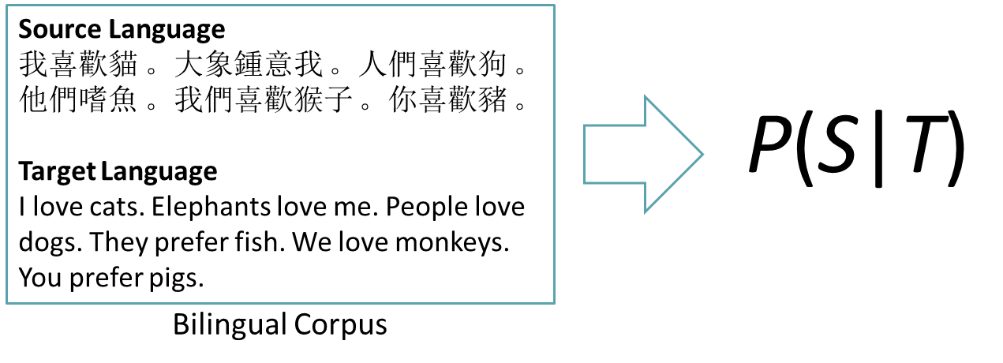
Translation Model
. ➔。cats ➔貓 dogs ➔狗
elephants ➔大象 fish ➔魚 I ➔我
prefer ➔喜歡 prefer ➔嗜
love ➔喜歡 love ➔鍾意
monkeys ➔ 猴子 pigs ➔ 豬
Sentence Alignment
我 喜歡 貓 。➔ I love cats .
大象 鍾意 我 。➔ Elephants love me .
人們 喜歡 狗 。➔ People love dogs .
他們 嗜 魚 。➔ They prefer fish .
我們 喜歡 猴子 。➔ We love monkeys .
你 喜歡 豬 。➔ You prefer pigs .
Word Alignment

Slide 20
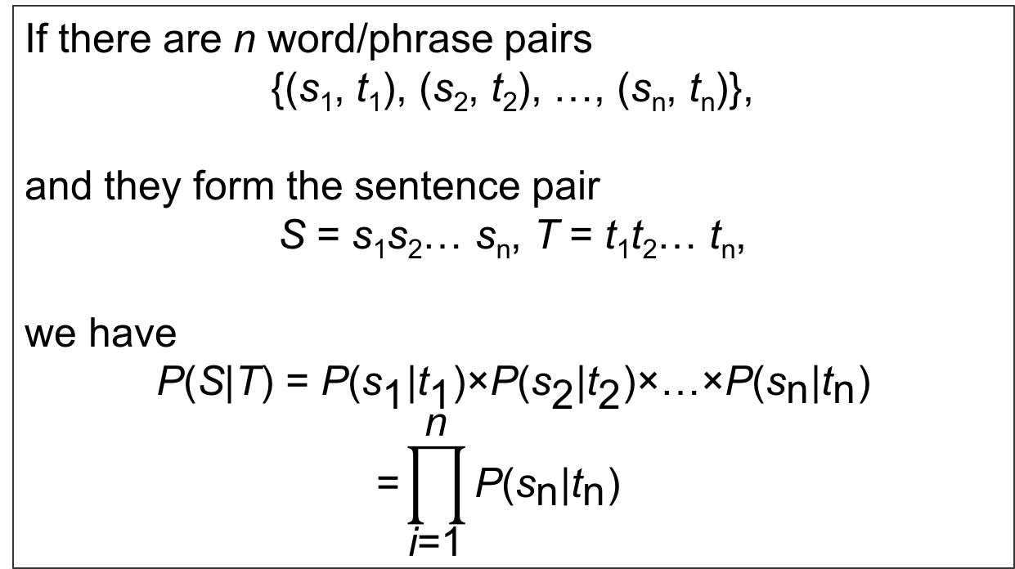
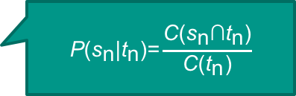
Translation Model P(S|T)
If there are n word/phrase pairs
{(s₁, t₁), (s₂, t₂), …, (s_{n}, t_{n})},
and they form the sentence pair
S $\text{=}$ s₁s₂… s_{n}, T $\text{=}$ t₁t₂… t_{n},
we have
$$\text{P}\text{(}\text{S}\text{|}\text{T}\text{) = }\text{P}\text{(}{\text{s}}_{\text{1}}\text{|}{\text{t}}_{\text{1}}\text{)×}\text{P}\text{(}{\text{s}}_{\text{2}}\text{|}{\text{t}}_{\text{2}}\text{)×…×}\text{P}\text{(}{\text{s}}_{\text{n}}\text{|}{\text{t}}_{\text{n}}\text{)}$$
$$\text{=}\prod_{\text{i}\text{=1}}^{\text{n}}{\text{P}\text{(}{\text{s}}_{\text{n}}\text{|}{\text{t}}_{\text{n}}\text{)}}$$
$$\text{P}\text{(}{\text{s}}_{\text{n}}\text{|}{\text{t}}_{\text{n}}\text{)=}\frac{\text{C}\text{(}{\text{s}}_{\text{n}}\text{∩}{\text{t}}_{\text{n}}\text{)}}{\text{C}\text{(}{\text{t}}_{\text{n}}\text{)}}$$

Slide 21
Translation Model
Given the following:
S = “我去遠足。”
T = “I go hiking.”
a set of phrase pairs
= {(“我”,“I”),(“去”,“go”),(“遠足”,“hiking”),(“。”,“.”)}
What is P(S|T) (i.e., the Probability of “我去遠足。” as the source of “I go hiking.”)?

Slide 22
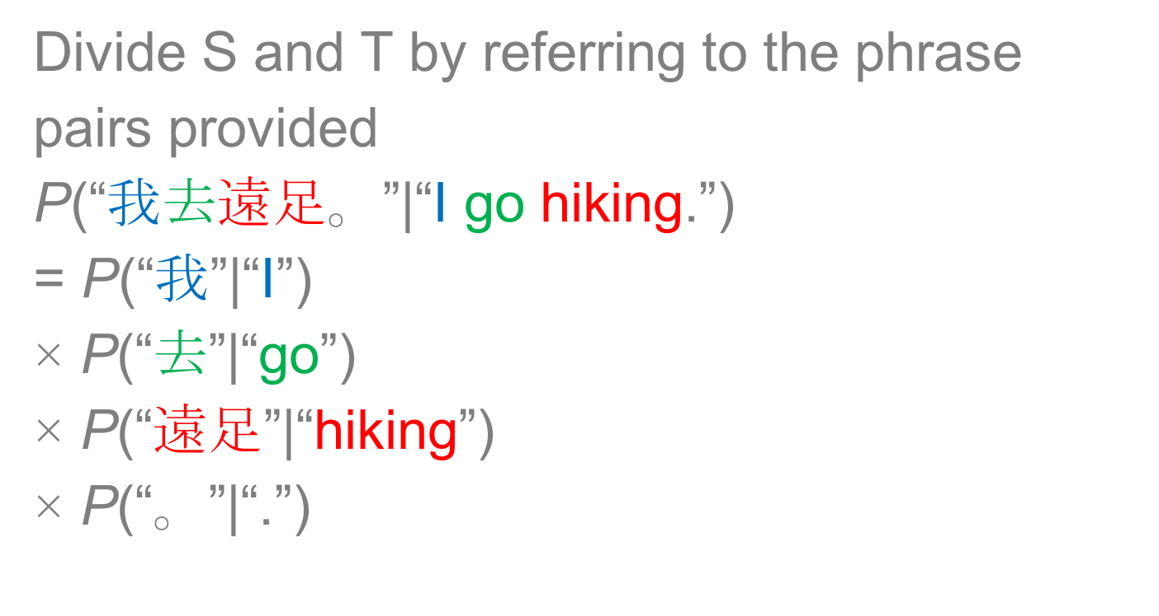
Translation Model
Divide S and T by referring to the phrase pairs provided
$$\text{P}\text{(“}\text{我}\text{去}\text{遠足}\text{。}\text{”|“}\text{I} \text{go} \text{hiking}\text{.”) }$$
$$\text{=} \text{P}\text{(“}\text{我}\text{”|“}\text{I}\text{”)}$$
$$\text{×} \text{P}\text{(“}\text{去}\text{”|“}\text{go}\text{”)}$$
$$\text{× }\text{P}\text{(“}\text{遠足}\text{”|“}\text{hiking}\text{”)}$$
$$\text{×} \text{P}\text{(“}\text{。}\text{”|“.”)}$$

Slide 23
SMT(3): Training

Slide 24
Training (1): Language Model
Monolingual Corpus
Monolingual Table
<BOS> Do you prefer fish ? <EOS>
<BOS> Elephants love her . <EOS>
<BOS> Give me fish . <EOS>
<BOS> They love elephants . <EOS>
<BOS> Dogs love swimming . <EOS>
<BOS> We love dogs . <EOS>

Slide 25
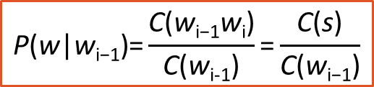
Training (1): Language Model
Bigrams
Probability
Log
Probability
$$\text{P}\text{(}\text{w}\text{|}\text{w}\text{i}\text{−1)=}\frac{\text{C}\text{(}\text{w}\text{i}\text{−1}\text{w}\text{i}\text{)}}{\text{C}\text{(}\text{w}\text{i}\text{−1}\text{)}}\text{=}\frac{\text{C}\text{(}\text{s}\text{)}}{\text{C}\text{(}\text{w}\text{i}\text{−1)}}$$

Slide 26
Training (2): Translation Model
Bilingual Corpus
Bilingual Table
我 喜歡 貓 。➔ I love cats .
大象 鍾意 我 。➔ Elephants love me .
人們 喜歡 狗 。➔ People love dogs .
他們 嗜 魚 。➔ They prefer fish .
我們 喜歡 猴子 。➔ We love monkeys .
你 喜歡 豬 。➔ You prefer pigs .

Slide 27
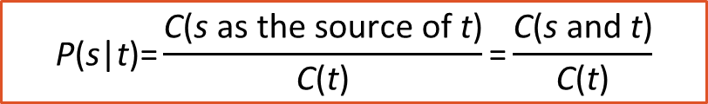
Training (2): Translation Model
s and t
Probability
Log
Probability
$$\text{P}\text{(}\text{s}\text{|}\text{t}\text{)=}\frac{\text{C}\text{(}\text{s} \text{as} \text{the} \text{source} \text{of} \text{t}\text{)}}{\text{C}\text{(}\text{t}\text{)}}\text{=}\frac{\text{C}\text{(}\text{s} \text{and} \text{t}\text{)}}{\text{C}\text{(}\text{t}\text{)}}$$

Slide 28
SMT(4): Decoding

Slide 29
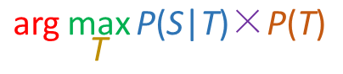
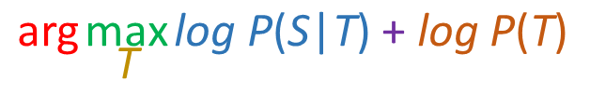
Decoding
Noisy-channel Model
Log-linear Model
Translation Model
Language
Model
Translation Model
Language
Model

Slide 30
Decoding (1): Extracting TL Expressions
狗喜歡大象。

Slide 31
Decoding (1): Extracting TL Expressions
T₁ = dogs elephants love.
T₂ = dogs love elephants.
T₃ = elephants dogs love.
T₄ = elephants love dogs.
T₅ = love elephant dogs.
T₆ = love dog elephants.
T₇ = dogs elephants prefer.
T₈ = dogs prefer elephants.
T₉ = elephants dogs prefer.
T₁₀ = elephants prefer dogs.
T₁₁ = prefer elephant dogs.
T₁₂ = prefer dog elephants.
{(“狗”,“dogs”),
(“大象”,“elephants”),
(“喜歡”,“prefer”),
(“喜歡”,“love”),
(“。”,“.”)}

Slide 32
Decoding (2): Selecting the Best Combination
T₁ = dogs elephants love.
T₂ = dogs love elephants.
T₃ = elephants dogs love.
T₄ = elephants love dogs.
T₅ = love elephant dogs.
T₆ = love dog elephants.
T₇ = dogs elephants prefer.
T₈ = dogs prefer elephants.
T₉ = elephants dogs prefer.
T₁₀ = elephants prefer dogs.
T₁₁ = prefer elephant dogs.
T₁₂ = prefer dog elephants.
{(“狗”,“dogs”),
(“大象”,“elephants”),
(“喜歡”,“prefer”),
(“喜歡”,“love”),
(“。”,“.”)}

Slide 33
Decoding (2): Selecting the Best Combination
Decoding Method 1: Noisy-channel Model
Final Score for a TT Candidate
= P(S|T) × P(T)

Slide 34
Details of Noisy-channel Model
T₂ = dogs love elephants.

Slide 35
Details of Noisy-channel Model
T₈ = dogs prefer elephants.

Slide 36
Decoding (2): Selecting the Best Combination
Decoding Method 2: Log-linear Model /
Maximum Entropy Model (Simplified)
Final Score for a TT Candidate
= log P(S|T) + log P(T)

Slide 37
Details of Log-linear Model
T₂ = dogs love elephants.

Slide 38
Details of Log-linear Model
T₈ = dogs prefer elephants.

Slide 39
More about NMT

Slide 40
NMT(1): Artificial Neural Networks

Slide 41
More about Artificial Neural Networks
Neural networks and back-propagation explained in a simple way (https://medium.com/datathings/neural-networks-and-backpropagation-explained-in-a-simple-way-f540a3611f5e)

Slide 42
More about Artificial Neural Networks
Back-Propagation is very simple. Who made it Complicated? (https://medium.com/@14prakash/back-propagation-is-very-simple-who-made-it-complicated-97b794c97e5c)

Slide 43
NMT(2): Word Embedding

Slide 44
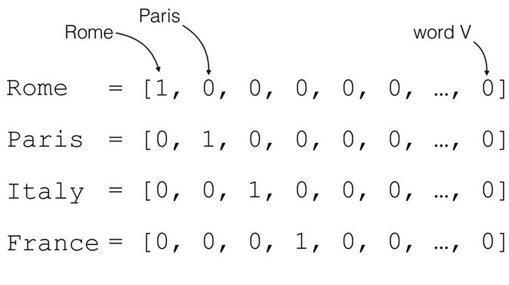
Word Embedding (1): One-hot Vector
For more information, visit
https://medium.com/@athif.shaffy/one-hot-encoding-of-text-b69124bef0a7

Slide 45
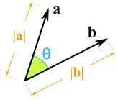
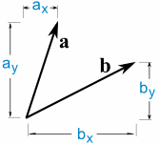
Problem
a · b = a_{x} × b_{x} + a_{y} × b_{y} = |a||b|cos(θ)
For more information, visit
https://www.mathsisfun.com/algebra/vectors-dot-product.html

Slide 46
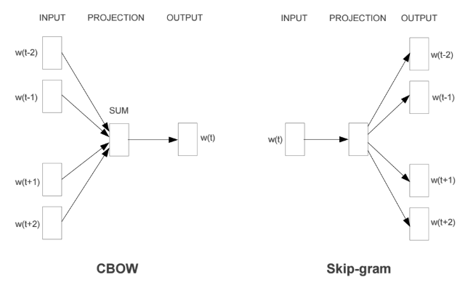
Word Embedding (2): Continuous Bag of Words and Skip-gram
For more information, visit
https://mubaris.com/2017/12/14/word2vec/

Slide 47
NMT(3): Activation functions

Slide 48
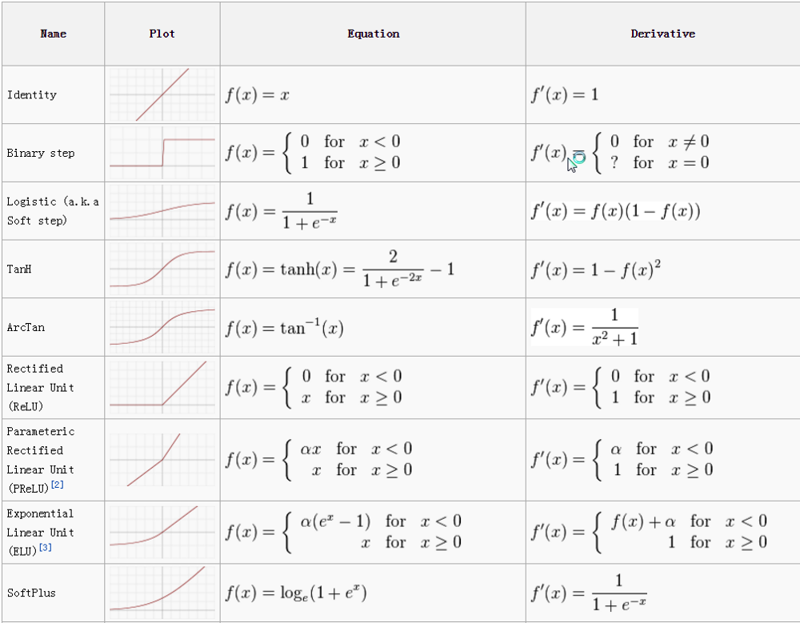
Activation functions
For more information, visit
https://towardsdatascience.com/activation-functions-neural-networks-1cbd9f8d91d6

Slide 49
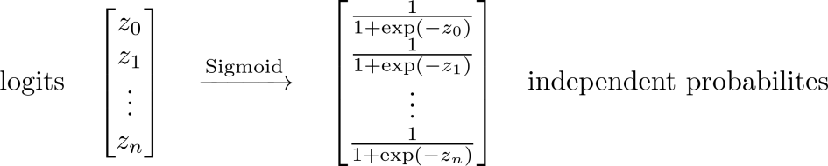
Softmax for Multi-class Classification (1)
The softmax function is a generalization of the logistic function that “squashes” a K-dimensional vector z of arbitrary real values to a K-dimensional vector of real values in the range [0, 1] that add up to 1.
[1.0,
2.0,
3.0,
4.0,
1.0]
[0.031062774127550943,
0.0844373744524495,
0.22952458061688552,
0.623912496675563,
0.031062774127550943]
For more information, visit
https://www.depends-on-the-definition.com/guide-to-multi-label-classification-with-neural-networks/

Slide 50
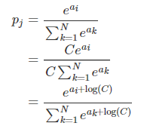
Softmax for Multi-class Classification (2)
Softmax function takes an N-dimensional vector of real numbers and transforms it into a vector of real number in range (0,1) which add up to 1.
For more information, visit
https://deepnotes.io/softmax-crossentropy

Slide 51
NMT(4): Training and Backpropagation

Slide 52
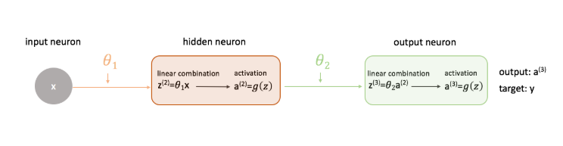
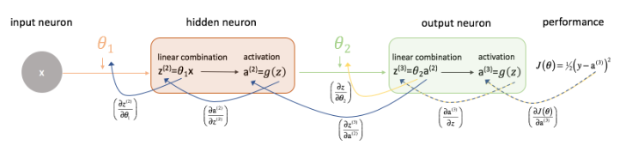
Training and Backpropagation
For more information, visit https://www.jeremyjordan.me/neural-networks-training/

Slide 53
NMT(5): RNN and LSTM

Slide 54
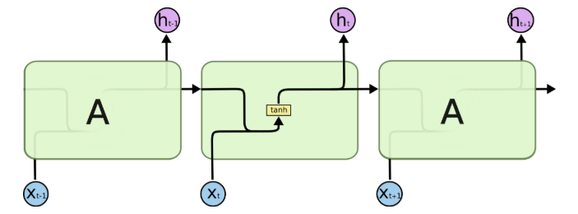
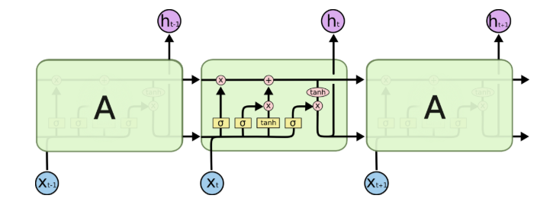
Standard RNN VS Long Short-term Memory
For more information, visit
http://colah.github.io/posts/2015-08-Understanding-LSTMs/

Slide 55
NMT(6): Types of NMT

Slide 56
Attention Mechanism
Given [I] / [go] / [to] / [school] / [by] / [bus] / [.], what is the next word?
我
[I] / [go] / [to] / [school] / [by] / [bus] / [.] / [我] ⇒ ?
乘
[I] / [go] / [to] / [school] / [by] / [bus] / [.] / [我] / [乘] ⇒ ?
公車
[I] / [go] / [to] / [school] / [by] / [bus] / [.] / [我] / [乘] / [公車] ⇒ ?
去
[I] / [go] / [to] / [school] / [by] / [bus] / [.] / [我] / [乘] / [公車] / [去] ⇒ ?
學校
[I] / [go] / [to] / [school] / [by] / [bus] / [.] / [我] / [乘] / [公車] / [去] / [學校] / ⇒ ?
。
Translation: 我乘公車去學校。
Note: [ ] refers to internal representation

Slide 57
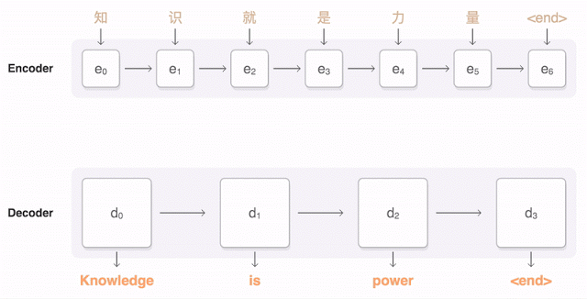
RNN Encoder-decoder with Attention
For more information, visit
https://ai.googleblog.com/2016/09/a-neural-network-for-machine.html

Slide 58
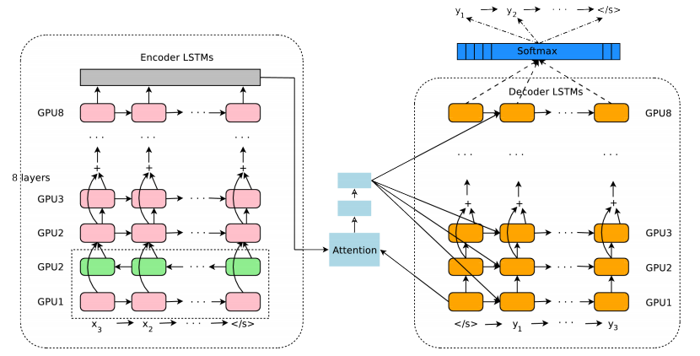
RNN Encoder-decoder with Attention
For more information, visit
https://arxiv.org/pdf/1609.08144.pdf

Slide 59
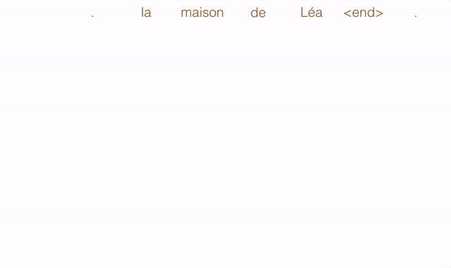
Convolutional NMT
For more information, visit
https://code.facebook.com/posts/1978007565818999/a-novel-approach-to-neural-machine-translation/

Slide 60
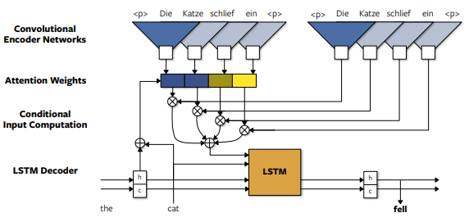
Convolutional NMT
For more information, visit
https://arxiv.org/pdf/1611.02344.pdf

Slide 61

Self-attentional Transformer
For more information, visit
https://ai.googleblog.com/2017/08/transformer-novel-neural-network.html

Slide 62
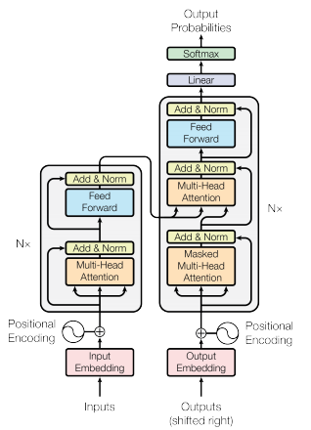
Self-attentional Transformer
For more information, visit
https://arxiv.org/pdf/1706.03762.pdf

